Slide 1
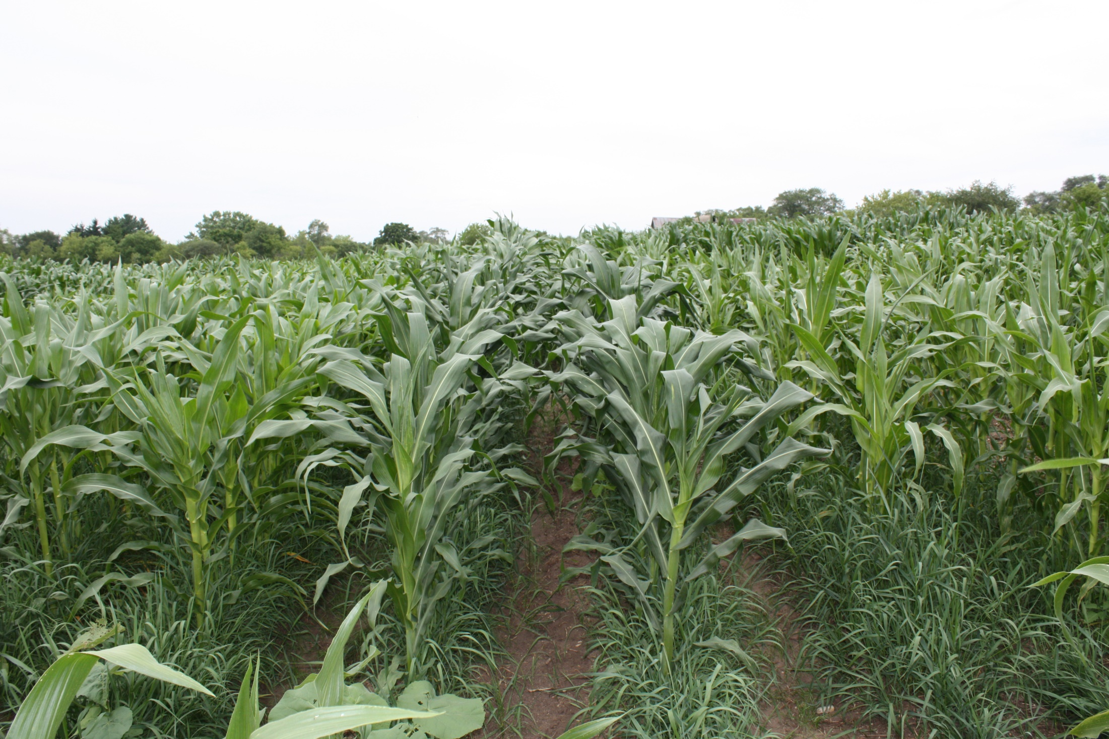
Photo 1. Nitrogen efficient breeding lines and lines that are not efficient growing on an unfertilized, Warsaw shallow, sandy loam in Little Prairie, Wisconsin after grass. The central two breeding lines showed darker foliage and less barren plants than the others.
Mexican Highland landrace 1 x Corn Belt inbred 1 (2x)-1-B-8-1 and 1-b-5-2
Mexican Highland Land race 1 x Corn Belt inbred 1 (2x)-1-B-4-8 and 1-b-4-9
(Argentine Landrace x Corn Belt inbred)1-5-1-4-8 and 1-5-1-4-9

